Slide 1

Intrusion Detection

Slide 2
Intrusion detection systems
packet filtering:
operates on TCP/IP headers only
no correlation check among sessions
IDS: intrusion detection system
deep packet inspection: look at packet contents (e.g., check character strings in packet against database of known virus, attack strings)
examine correlation among multiple packets
port scanning
network mapping
DoS attack

Slide 3


Intrusion detection systems
multiple IDSs: different types of checking at different locations
firewall
internal
network
Internet
IDS
sensors
Web
server
DNS
server
FTP
server
demilitarized
zone

Slide 4
First Line of Defense: The Firewall
Primary means of securing a private network against penetration from a public network
An access control device, performing perimeter security by deciding which packets are allowed or denied, and which must be modified before passing
Core of enterprise’s comprehensive security policy
Can monitor all traffic entering and leaving the private network, and alert the IT staff to any attempts to circumvent security or patterns of inappropriate use

Slide 5
Network Firewall Concept
Your
Domain
Violations
Firewall
System
Legitimate Activity

Slide 6
Types Of Firewall
Basic Router Security; includes Access control Lists (ACLs) and Network Address Translation (NAT)
Packet Filtering; includes inspection of data packets based on header information, source and destination addresses and ports and message protocol type etc
Stateful Inspections; includes packet inspections based on sessions and tracking of individual connections. Packets are allowed to pass only if associated with a valid session initiated from within the network.
Application Level Gateways; (Proxy servers) protect specific network services by restricting the features and commands that can be accessed from outside the network. Presents reduced feature sets to external users

Slide 7
Introduction to IDS
IDSs prepare for and deal with attacks by collecting information from a variety of system and network sources, then analyzing the symptoms of security problems
IDSs serve three essential security functions; monitor, detect and respond to unauthorized activity
IDS can also response automatically (in real-time) to a security breach event such as logging off a user, disabling a user account and launching of some scripts

Slide 8
Some of the benefits of IDS
Monitors the operation of firewalls, routers, key management servers and files critical to other security mechanisms
Allows administrator to tune, organize and comprehend often incomprehensible operating system audit trails and other logs
Can make the security management of systems by non-expert staff possible by providing nice user friendly interface
Comes with extensive attack signature database against which information from the customers system can be matched
Can recognize and report alterations to data files

Slide 9
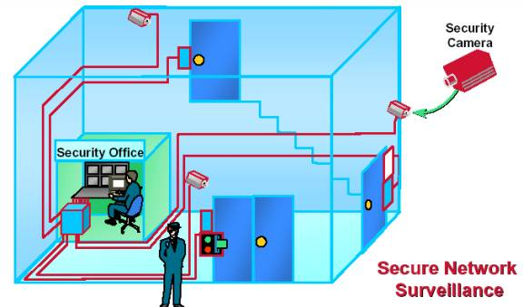
FIREWALLS VS IDSs

Slide 10
FIREWALL VS IDS (cont)
Firewall cannot detect security breaches associated with traffic that does not pass through it. Only IDS is aware of traffic in the internal network
Not all access to the Internet occurs through the firewall.
Firewall does not inspect the content of the permitted traffic
Firewall is more likely to be attacked more often than IDS
Firewall is usually helpless against tunneling attacks
IDS is capable of monitoring messages from other pieces of security infrastructure

Slide 11
TYPES OF IDS
HOST – BASED (HIDS)
NETWORK – BASED (NIDS)
HYBRID

Slide 12
HIDS
Works in switched network environments
Operates in encrypted environments
Detects and collects the most relevant information in the quickest possible manner
Tracks behavior changes associated with misuse.
Requires the use of the resources of a host server – disk space, RAM and CPU time
Does not protect entire infrastructure

Slide 13
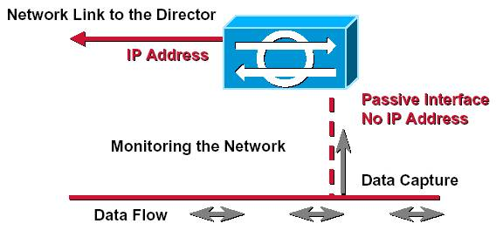
NIDS
PASSIVE Interface to Network Traffic

Slide 14
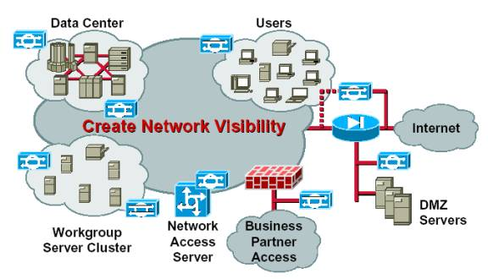
NIDS (cont) Sensor Placement

Slide 15
NIDS (cont) Advantages
NIDS uses a passive interface to capture network packets for analyzing.
NIDS sensors placed around the globe can be configured to report back to a central site, enabling a small team of security experts to support a large enterprise.
NIDS systems scale well for network protection because the number of actual workstations, servers, or user systems on the network is not critical – the amount of traffic is what matters
Most network-based IDSs are OS-Independent
Provide better security against DOS attacks

Slide 16
NIDS (cont) Disadvantages
Cannot scan protocols or content if network traffic is encrypted
Intrusion detection becomes more difficult on modern switched networks
Current network-based monitoring approaches cannot efficiently handle high-speed networks
Most of Network-based systems are based on predefined attack signatures--signatures that will always be a step behind the latest underground exploits

Slide 17
HYBRID
Although the two types of Intrusion Detection Systems differ significantly from each other, but they also complement each other.
Such a system can target activity at any or all levels
It is easier to see patterns of attacks over time and across the network space
No proven industry standards with regards to interoperability of intrusion detection components
Hybrid systems are difficult to manage and deploy

Slide 18
Principles of System Design
Two extremes of what’s “permitted” and not!
Whatever is not explicitly permitted is forbidden
Whatever is not explicitly forbidden is permitted
Limitations
To forbid things, you need to know their characteristics
Modeling of applications, processes, and systems is “incomplete”
Model three kinds of system issues
Faults (hardware, software, permanent, transient)
Quality of service failures
Intrusions/Attacks

Slide 19
Principles of Intrusion Detection
Characteristics of systems not under attack
User, process actions conform to statistically predictable pattern
User, process actions do not include sequences of actions that subvert the security policy
Process actions correspond to a set of specifications describing what the processes are allowed to do
Systems under attack do not meet at least one of these

Slide 20
Example
Goal: suppose we wanted to insert a back door
Intruder will modify system configuration file or program
Requires privilege; attacker enters system as an unprivileged user and must acquire privilege
Non-privileged user may not normally acquire privilege
violates #1
Attacker may break in using sequence of commands that violate security policy
violates #2
Attacker may cause program to act in ways that violate program’s specification
Violates #3

Slide 21
Basic Intrusion Detection
Attack tool is automated script designed to violate a security policy
Example: rootkit
Includes password sniffer
Designed to hide itself using Trojaned versions of various programs (ps, ls, find, netstat, etc.)
Adds back doors (login, telnetd, etc.)
Has tools to clean up log entries (zapper, etc.)

Slide 22
Basic Intrusion Detection
BUT … Rootkit configuration files cause ls, du, etc. to hide information
ls lists all files in a directory
Except those hidden by configuration file
dirdump (local program to list directory entries) lists them too
Run both and compare counts
If they differ, ls is doctored
Key point:
Rootkit does not alter kernel or file structures to conceal files, processes, and network connections
It alters the programs or system calls that interpret those structures
Find some entry point for interpretation that rootkit did not alter
The inconsistency is an anomaly (violates #1)
Notes:
A rootkit is a collection of computer software, typically malicious, designed to enable access to a computer or areas of its software that is not otherwise allowed (for example, to an unauthorized user) and often masks its existence or the existence of other software.

Slide 23
Denning’s Model
Hypothesis: exploiting vulnerabilities requires abnormal use of normal commands or instructions
Includes deviation from usual actions
Includes execution of actions leading to break-ins
Includes actions inconsistent with specifications of privileged programs

Slide 24
Goals of IDS
Detect wide variety of intrusions
Previously known and unknown attacks
Suggests need to learn/adapt to new attacks or changes in behavior
Detect intrusions in timely fashion
"Timely" varies
Present analysis in simple, easy-to-understand format
Ideally a binary indicator, but usually more complex than yes/no
User interface critical, especially when monitoring many systems
Be accurate
Minimize false positives, false negatives
Minimize time spent verifying attacks, looking for them
Be non-invasive
Should not affect performance appreciably
Should be perceived as more helpful than hurtful

Slide 25
Models of Intrusion Detection
Anomaly detection
What is usual, is known
What is unusual, is bad
Misuse detection
What is bad, is known
What is not bad, is good
Specification-based detection
What is good, is known
What is not good, is bad

Slide 26
Anomaly Detection
Analyzes a set of characteristics of system, and compares their values with expected values; report when computed statistics do not match expected statistics
Threshold metrics
Statistical moments
Markov model

Slide 27
Threshold Metrics
Counts number of events that occur
Between m and n events expected to occur
If number falls outside this range, anomalous
Example
Windows: lock user out after k failed sequential login attempts. Range is (0, k–1).
k or more failed logins deemed anomalous
Flaws in this approach?

Slide 28
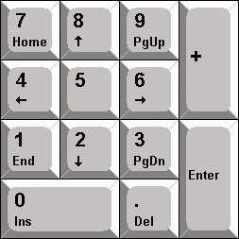





Difficulties
Appropriate threshold may depend on non-obvious factors
Typing skill of users
Keyboard layout
Keyboard origin

Slide 29

Notes:
Hansen Writing Ball

Slide 30
Statistical Moments*
Uses standard deviation and other measures of correlation
If measured values fall outside expected interval for particular moments, anomalous
Potential problem
Profile may evolve over time; solution is to weigh data appropriately or alter rules to take changes into account
Flaws in this approach?
*a method of estimating a population's characteristics

Slide 31
Example
Intrusion Detection Expert System (Denning)
Represent users, login session, other entities as ordered sequence of statistics <q_{0,j}, …, q_{n,j}>
q_{i,j} (statistic i for day j) is count or time interval
Weighting favors recent behavior over past behavior
A_{k,j} sum of counts making up metric of kth statistic on jth day
q_{k,l+1} = A_{k,l+1} – A_{k,l} + 2^{–rt}q_{k,l} where t is number of log entries/total time since start, r factor determined through experience
How do we determine what should be q'ed?
Flaws in this approach?

Slide 32
Potential Problems
Assumes behavior of processes and users can be modeled statistically
Ideal: matches a known distribution such as Gaussian or normal
Otherwise, must use techniques like clustering to determine moments, characteristics that show anomalies, etc.
Real-time computation a problem too

Slide 33
Markov Model
Past state affects current transition
Anomalies based upon sequences of events, and not on occurrence of single event
Problem: need to train system to establish valid sequences
Use known, training data that is not anomalous
The more training data, the better the model
Training data should cover all possible normal uses of system

Slide 34
Example
Time-based Inductive Learning (DEC)
Sequence of events is abcdedeabcabc
Derive following rules:
R₁: ab→c (1.0) R₂: c→d (0.5) R₃: c→e (0.5)
R₄: d→e (1.0) R₅: e→a (0.5) R₆: e→d (0.5)
Seen: abd
triggers alert
c always follows ab in rule set
Seen: acf
strict interpretation: trigger alert since only d and e follow c
probabilistic interpretation: no alert as multiple events can follow c
May add rule R₇: c→f (0.33); adjust R₂, R₃

Slide 35
Models of Intrusion Detection
Anomaly detection
What is usual, is known
What is unusual, is bad
Misuse detection
What is bad, is known
What is not bad, is good
Specification-based detection
What is good, is known
What is not good, is bad

Slide 36
Misuse Modeling
Determines whether a sequence of instructions being executed is known to violate the site security policy
Descriptions of known or potential exploits grouped into rule sets
IDS matches data against rule sets; on success, potential attack found
Cannot detect attacks unknown to developers of rule sets
No rules to cover them

Slide 37
Example
Network Flight Recorder
Built to make adding new rules easily
Architecture:
Packet sucker: read packets from network
Decision engine: uses filters to extract information
Backend: write data generated by filters to disk
Query backend allows administrators to extract raw, postprocessed data
Query backend is separate from NFR process
Filters written in N-code language
Example: ignore all traffic not intended for 2 web servers:
# list of my web servers
my_web_servers = [ 10.237.100.189 10.237.55.93 ] ;
# we assume all HTTP traffic is on port 80
filter watch tcp ( client, dport:80 )
{
if (ip.dest != my_web_servers)
return;
# now process the packet; we just write out packet info
record system.time, ip.src, ip.dest to www._list;
}
www_list = recorder(“log”)

Slide 38
Models of Intrusion Detection
Anomaly detection
What is usual, is known
What is unusual, is bad
Misuse detection
What is bad, is known
What is not bad, is good
Specification-based detection
What is good, is known
What is not good, is bad

Slide 39
Specification Modeling
Determines whether execution of sequence of instructions violates specification
has side benefit of forcing upfront specification of security policy … requiring analysis of legal/illegal operations
Only need to check programs that alter protection state of system

Slide 40
Example
rdist creates temp file, copies contents into it, changes protection mask, copies it into place
Attack: during copy, delete temp file and place symbolic link with same name as temp file
symbolic link points to a file with attacker's access
rdist changes mode, then copies
Specification modeling
Specification of chmod, chown says that they can only alter attributes of files that rdist creates
Chown, chmod of symbolic link violates this rule because owner of linked file is not owner of file rdist is distributing
Notes:
Rdist is a program to maintain identical copies of files over multiple hosts. It preserves the owner, group, mode, and mtime of files if possible and can update programs that are executing. Rdist reads commands from distfile to direct the updating of files and/or directories.

Slide 41
Comparison and Contrast
Misuse detection: if all policy rules known, easy to construct rulesets to detect violations
Usual case is that much of policy is unspecified, so rulesets describe attacks, and are not complete
Anomaly detection: detects unusual events, but these are not necessarily security problems
Specification-based vs. misuse:
spec assumes if specifications followed, policy not violated
misuse assumes if policy as embodied in rule sets followed, policy not violated

Slide 42
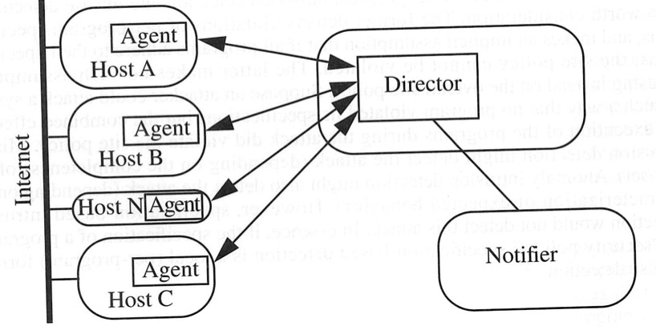
IDS Architecture
Fundamentally, a sophisticated audit system
Agent
Gathers data for analysis
Director
Analyzes data obtained from agents according to internal rules
Notifier
Obtains results from director, takes some action
May simply notify security officer
May reconfigure agents, director to alter collection, analysis methods
May activate response mechanism

Slide 43
Agents
Obtain information and send to director
May put information into another form
Preprocessing of records to extract relevant parts
May delete unneeded information
Many may exist
Director may request agent send other information

Slide 44
Example
IDS uses failed login attempts in its analysis
Agent scans login log every 5 minutes, sends director for each new login attempt:
Time of failed login
Account name and entered password
Director requests all records of login (failed or not) for particular user
Suspecting a brute-force cracking attempt

Slide 45
Host-Based Agent
Obtain information from logs
May use many logs as sources
May be security-related or not
May be virtual logs if agent is part of the kernel
Agent generates its information
Scans information needed by IDS, turns it into equivalent of log record
Typically, check policy; may be very complex

Slide 46
Network-Based Agents
Detects network-oriented attacks
Denial of service attack introduced by flooding a network
Monitor traffic for a large number of hosts
Examine the contents of the traffic itself
Agent must have same view of traffic as destination
TTL tricks, fragmentation may obscure this
End-to-end encryption defeats content monitoring
but not traffic analysis
Network architecture dictates agent placement
Ethernet or broadcast medium: one agent per subnet
Point-to-point medium: one agent per connection, or agent at distribution/routing point
Focus is usually on intruders entering network
If few entry points, place network agents behind them
Does not help if inside attacks to be monitored

Slide 47
Aggregation of Information
Agents produce information at multiple layers of abstraction
Application-monitoring agents provide one view (usually one line) of an event
System-monitoring agents provide a different view (usually many lines) of an event
Network-monitoring agents provide yet another view (involving many network packets) of an event

Slide 48
Director
Fuses information from agents
Eliminates unnecessary, redundant records
Analyzes remaining information to determine if attack under way
Analysis engine can use a number of techniques, discussed before, to do this
Usually run on separate system
Does not impact performance of monitored systems
Rules, profiles not available to ordinary users

Slide 49
Example
Jane logs in to perform system maintenance during the day
She logs in at night to write reports
One night she begins recompiling the kernel
Agent #1 reports logins and logouts
Agent #2 reports commands executed
Neither agent spots discrepancy
Director correlates log, spots anomaly

Slide 50
Adaptive Directors
Modify profiles, rule sets to adapt their analysis to changes in system
Usually use machine learning or planning to determine how to do this
Example: use neural nets to analyze logs
Network adapted to users’ behavior over time
Used learning techniques to improve classification of events as anomalous
Reduced number of false alarms

Slide 51
Monitoring Networks
Groundwork
Develop profile of expected usage of network behavior, compares current usage
Pioneered with Network Security Monitor (NSM)
Common approach: conceptual 3-D matrix for data
Axes are source, destination, service
Each connection has unique connection ID
Cell contents typically a tuple
number of packets sent over that connection for a period of time
metric of data (such as sum of data, data length, etc.)
Rules describe what data to mask
Anything left over is reported as an anomaly

Slide 52
Problem: Lots of Data
Solution: arrange data hierarchically into groups
Construct by folding axes of matrix
Analyst could expand any group flagged as anomalous
S₁
(S₁, D₁)
(S₁, D₂)
(S₁, D₁, SMTP)
(S₁, D₁, FTP)
…
(S₁, D₂, SMTP)
(S₁, D₂, FTP)
…

Slide 53
Signatures
Analyst can write rule to look for specific occurrences in matrix
Repeated telnet connections lasting only as long as set-up indicates failed login attempt
Analyst can write rules to match against network traffic
Used to look for excessive logins, attempt to communicate with non-existent host, single host communicating with 15 or more hosts

Slide 54
Notifier
Accepts information from director
Takes appropriate action
Notify system security officer
Respond to attack
Often GUIs
Well-designed ones use visualization to convey information

Slide 55
Agents
Distribute director among agents
Autonomous agent is process that can act independently of the system of which it is part
Autonomous agent performs one particular monitoring function
Has its own internal model
Communicates with other agents
Agents jointly decide if these constitute a reportable intrusion

Slide 56
Agents (con't)
Advantages
No single point of failure
All agents can act as director
In effect, director distributed over all agents
Compromise of one agent does not affect others
Agent monitors one resource
Small and simple
Agents can migrate if needed
Approach appears to be scalable to large networks
Disadvantages
Communications overhead higher, more scattered than for single director
Securing these can be very hard and expensive
As agent monitors one resource, need many agents to monitor multiple resources
Distributed computation involved in detecting intrusions
This computation also must be secured

Slide 57

Warning: Heart warming cute picture is about to appear.
May be hazardous to health.

Slide 58
Incident Prevention
Identify attack before it completes
Prevent it from completing
Jails useful for this
Attacker placed in a confined environment that looks like a full, unrestricted environment
Attacker may download files, but gets bogus ones
Can imitate a slow system, or an unreliable one
Useful to figure out what attacker wants
MLS systems provide natural jails
Notes:
MLS -- Multilevel security or multiple levels of security (MLS) is the application of a computer system to process information with incompatible classifications (i.e., at different security levels), permit access by users with different security clearances and needs-to-know, and prevent users from obtaining access to information for which they lack authorization.

Slide 59
Intrusion Handling
Restoring system to satisfy site security policy
Six phases
Preparation for attack (before attack detected)
Identification of attack
Containment of attack (confinement)
Eradication of attack (stop attack)
Recovery from attack (restore system to secure state)
Follow-up to attack (analysis and other actions)

Slide 60
Containment Phase
Goal: limit access of attacker to system resources
Two methods
Passive monitoring
Records attacker’s actions; does not interfere with attack
Idea is to find out what the attacker is after and/or methods the attacker is using
Problem: attacked system is vulnerable throughout
Attacker can also attack other systems
Example: type of operating system can be derived from settings of TCP and IP packets of incoming connections
Analyst draws conclusions about source of attack
Constraining access
Reduce protection domain of attacker
Problem: if defenders do not know what attacker is after, reduced protection domain may contain what the attacker is after
Stoll created document that attacker downloaded
Download took several hours, during which the phone call was traced to Germany

Slide 61
Protection Domain
A protection domain is a grouping of a code source and permissions--that is, a protection domain represents all the permissions that are granted to a particular [user, code source, session, etc].

Slide 62
Containment Phase (con't)
Deception Tool Kit
Creates false network interface
Can present any network configuration to attackers
When probed, can return wide range of vulnerabilities
Attacker wastes time attacking non-existent systems while analyst collects and analyzes attacks to determine goals and abilities of attacker
Experiments show deception is effective response to keep attackers from targeting real systems

Slide 63
Eradication Phase
Usual approach: deny or remove access to system, or terminate processes involved in attack
Use wrappers to implement access control
Example: wrap system calls
On invocation, wrapper takes control of process
Wrapper can log call, deny access, do intrusion detection
Experiments focusing on intrusion detection used multiple wrappers to terminate suspicious processes
Example: network connections
Wrapper around servers log, do access control on, incoming connections and control access to Web-based databases

Slide 64
Eradication Phase (cont')
Firewalls
Mediate access to organization’s network
Also mediate access out to the Internet
Example: Java applets filtered at firewall
Use proxy server to rewrite them
Change “<applet>” to something else
Discard incoming web files with hex sequence CA FE BA BE
All Java class files begin with this
Block all files with name ending in “.class” or “.zip”
Lots of false positives

Slide 65
Eradication Phase (con't)
Intrusion Detection and Isolation Protocol
Coordinates response to attacks
Boundary controller blocks connection from entering perimeter
Typically firewalls or routers
Neighbor is system directly connected
IDIP domain is set of systems that can send messages to one another without messages passing through boundary controller
Protocol
IDIP protocol engine monitors connection passing through members of IDIP domains
If intrusion observed, engine reports it to neighbors
Neighbors propagate information about attack
Trace connection, datagrams to boundary controllers
Boundary controllers coordinate responses
Usually, block attack, notify other controllers to block relevant communication

Slide 66
Eradication Phase (con't)
Intrusion Detection and Isolation Protocol
C, D, W, X, Y, Z boundary controllers
f launches denial of service attack on A
a detects traffic, blocks it, notifies W
W detects traffic, blocks it, notifies X
X detects traffic, blocks it, notifies Y and C
W detects lack of traffic, unblocks
etc
C
D
b
Y
X
e
A
W
Z
a
f

Slide 67
Follow-Up Phase
Take action external to system against attacker
Thumbprinting: traceback at the connection level
IP header marking: traceback at the packet level
Counterattacking

Slide 68
Follow-up Phase (con't)
Counterattacking
Use legal procedures
Collect chain of evidence so legal authorities can establish attack was real
Check with lawyers for this
Rules of evidence very specific and detailed
If you don’t follow them, expect case to be dropped
Technical attack
Goal is to damage attacker seriously enough to stop current attack and deter future attacks
Consequences
May harm innocent party
Attacker may have broken into source of attack or may be impersonating innocent party
May have side effects
If counterattack is flooding, may block legitimate use of network
Antithetical to shared use of network
Counterattack absorbs network resources and makes threats more immediate
May be legally actionable

Slide 69
Key Points
Intrusion detection is a form of auditing
General concepts:
Anomaly detection looks for unexpected events
Misuse detection looks for what is known to be bad
Specification-based detection looks for what is known not to be good
Intrusion detection mechanisms:
agents
director
notifier
Intrusion response requires careful thought and planning
Preparation for attack (before attack detected)
Identification of attack
Containment of attack (confinement)
Eradication of attack (stop attack)
Recovery from attack (restore system to secure state)
Follow-up to attack (analysis and other actions)

